Slide 1

Perceptron
Dr. Linrui Zhang
University of Central Missouri

Slide 2
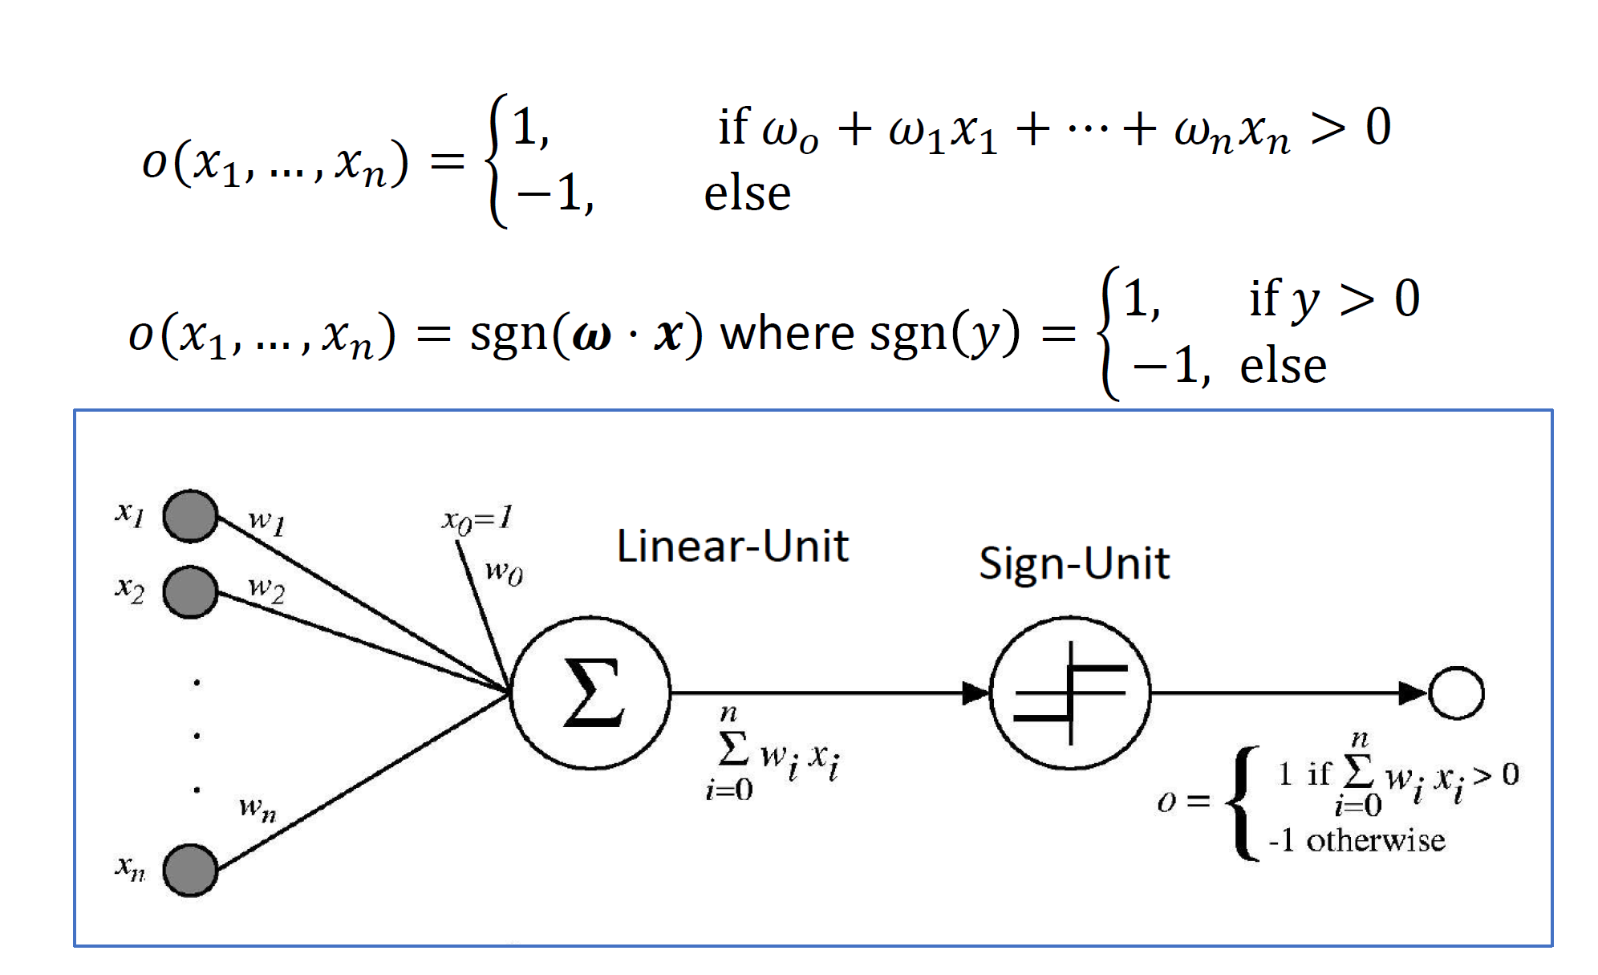
Perceptron - Representation

Slide 3
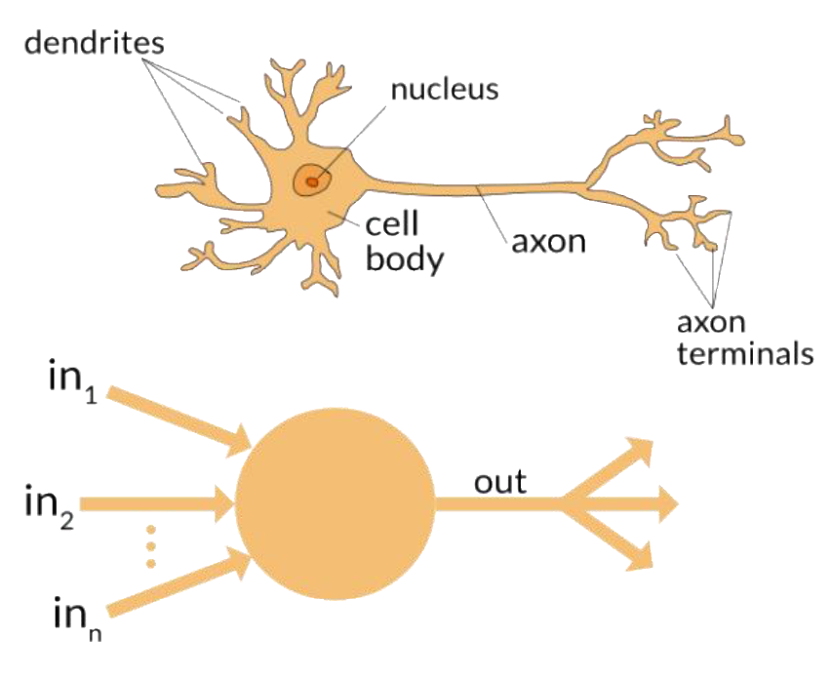
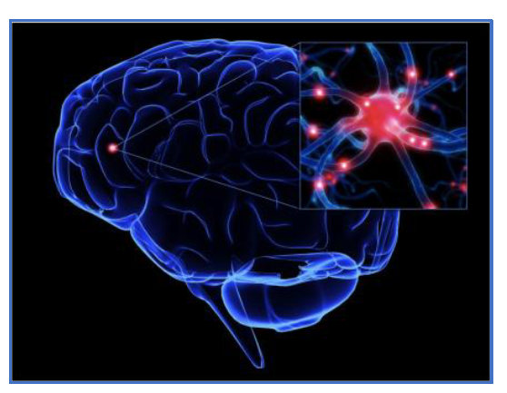
Perceptron

Slide 4
Perceptron - Representation
Perceptron as Logical Operators
AND Perceptron
w₁ + w₂ + w₀ ≥ 0
w₁ + w₀ < 0
w₂ + w₀ < 0
w₀ <0
Find w₁, w₂ and b to fit the inequality (there are multiple answers)
w₁ = 0.7 w₂ = 0.5 w₀ = -1
x1 | x2 | y
1 | 1 | 1
1 | 0 | 0
0 | 1 | 0
0 | 0 | 0

Slide 5
Homework
Can a perceptron implement the OR logical function? If your answer is yes, draw the perceptron in the space provided below. If your answer is no, explain why?

Slide 6
Discussion Question
Can a perceptron implement the Negation logical function? If your answer is yes, draw the perceptron in the space provided below. If your answer is no, explain why?
Can a perceptron implement the XOR logical function? If your answer is yes, draw the perceptron in the space provided below. If your answer is no, explain why?

Slide 7
Perceptron - Training
Training a Perceptron
Method 1: Perceptron Training Rule
Evaluation: reduce the number of incorrectly classified instances
Method 2: Delta Rule/Gradient Descent

Slide 8

Perceptron Training Rule
Formula:
w_{i} w_{i} + η(t - o)x_{i}
Where
t is target value
o is perceptron output
η is learning rate (e.g., 0.1)

Slide 9
Perceptron - Representation
The Perceptron is a linear classification algorithm.
It learns a decision boundary that separates two classes using a line (called a hyperplane) in the feature space.

Slide 10
Perceptron Training Rule
The perceptron learning algorithm is a linear classifier. If your data is separable by a hyperplane, then the perceptron will always converge. It will never converge if the data is not linearly separable.

Slide 11
Example
Apply the perceptron learning algorithm for the following pattern set until convergence. Start with weight vector (b, w₁, w₂, w₃) = (1, 0, 0, 0). For each step of perceptron learning written down the applied pattern, the classification result and the update of the weight vector. Given η = 1.
X₀ | X₁ | X₂ | X₃ | Y
1 | 4 | 3 | 6 | 0
1 | 2 | -2 | 3 | 1
1 | 1 | 0 | -3 | 1
1 | 4 | 2 | 3 | 0

Slide 12
Example
data | Output | True label | update | new weight vector
(x_{i}) | (o) | (t) | η(t - o)x_{i} | (1, 0, 0, 0)
(1, 4, 3, 6) | + | - | -(1,4,3,6) | (0, -4, -3, -6)
(1, 2, -2, 3) | - | + | +(1,2,-2,3) | (1, -2, -5, -3)
(1, 1, 0. -3) | + | + | unchanged | unchanged
(1, 4, 2, 3) | - | - | unchanged | unchanged
(1, 4 , 3, 6) | - | - | unchanged | unchanged
(1, 2, -2, 3) | - | + | +(1,2,-2, 3) | (2, 0, -7, 0)
(1, 1, 0 , -3) | + | + | unchanged | unchanged
(1, 4, 2, 3) | - | - | unchanged | unchanged
(1, 4, 3, 6) | - | - | unchanged | unchanged
(1, 2, -2. 3) | + | + | unchanged | unchanged

Slide 13
Quiz
Apply the perceptron learning algorithm for the following pattern set. Start with weight vector (b, w₁, w₂)= (1, 0, 0). Apply the patterns in the given order cyclically. For each step of perceptron learning written down the applied pattern, the classification result and the update of the weight vector. Given η = 1.
X₀ | X₁ | X₂ | Class
1 | 1 | 1 | +
1 | 1 | 0 | -
1 | 0 | 0 | +
1 | 0 | 1 | -

